Slide 1
Continuous Delivery with .NET Core, Docker, Azure, and visual studio team services
Dave Milner

Slide 2

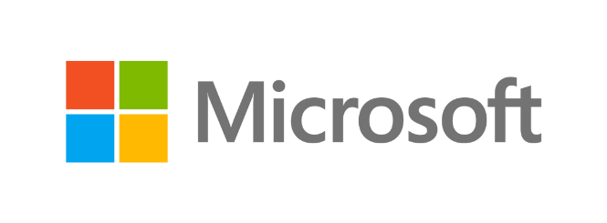




Denver Dev Day - June 23, 2017
"Donations by YOU, Denver Dev Day attendees,
are provided to support KidsTek, http://kidstek.org - Thank you!"

Slide 3

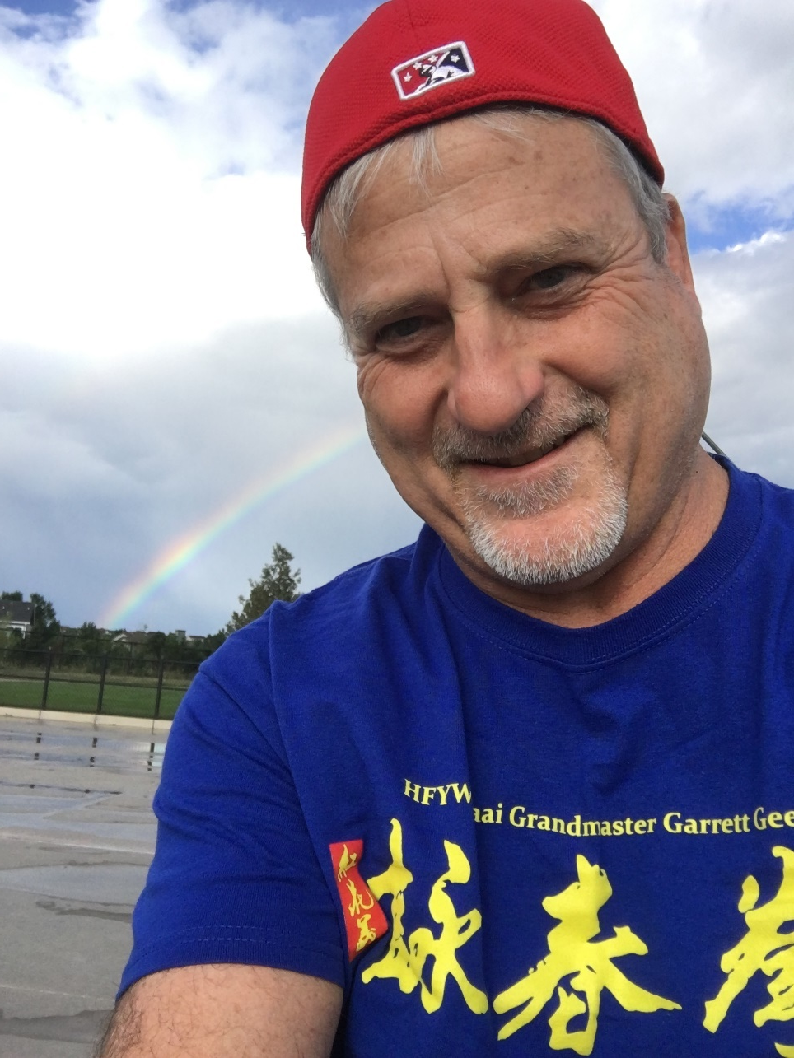
Dave Milner - Phidiax
Sr. Collaboration & Cloud Architect
Background
SharePoint and Office 365
.NET development
JavaScript development
Current Focus
Cloud / Azure
Open Source
DevOps

Slide 4
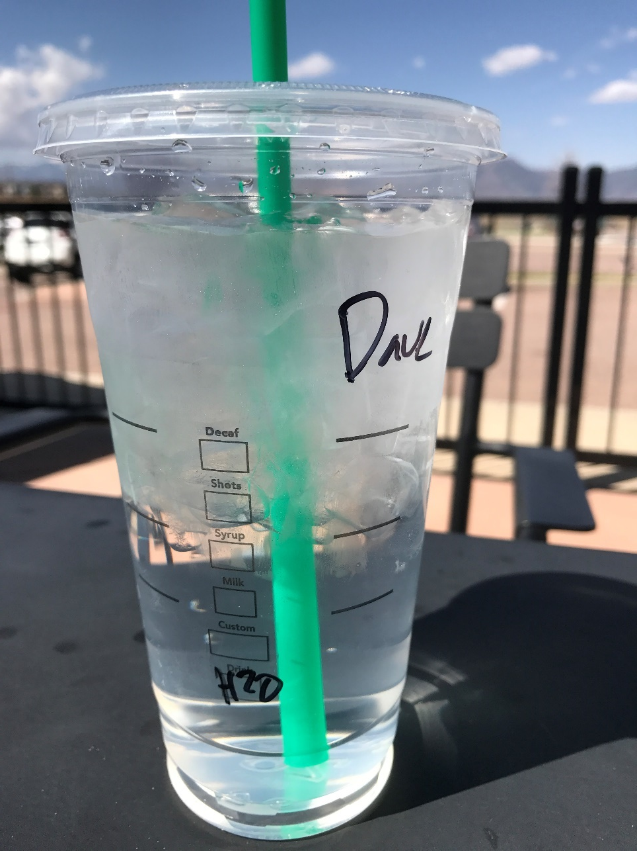
H2O for Life
Open source project
https://github.com/davemilner/h2oforlife
Background
Dev Junkyards
Personal injury
Water consumption monitoring
Focus
Water consumption tracking
Demos – toward this effort

Slide 5

Agenda
Continuous Delivery
DevOps
Azure
Docker
Visual Studio Team Services
Platform Agnostic
Tying Components Together
Purpose
Introduce to CD Trend - DevOps
Advances in Tools
VSTS
Azure
Docker

Slide 6
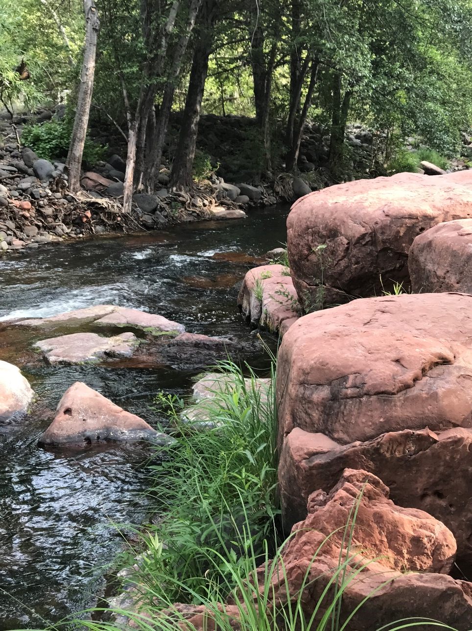
Continuous Delivery
“Continuous delivery (CD) is a software engineering approach in which teams produce software in short cycles, ensuring that the software can be reliably released at any time. “
“It aims at building, testing, and releasing software faster and more frequently.”
“The approach helps reduce the cost, time, and risk of delivering changes by allowing for more incremental updates to applications in production” – Wikipedia

Slide 7

Continuous Delivery
“Continuous delivery (CD) is the ability to get changes of all types – into production, or into the hands of users, safely and quickly in a sustainable way” Jez Humble – continuousdelivery.com

Slide 8

DevOps and Continuous Delivery
“Continuous delivery and DevOps are similar in their meanings and are often conflated, but they are two different concepts. DevOps has a broader scope, and centers around the cultural change, specifically the collaboration of the various teams involved in software delivery (developers, operations, quality assurance, management, …) as well as automating the processes in software delivery. “ wikipedia

Slide 9

DevOps
Why important now?
Competition
Velocity
Reduce downtime, human error
What Is It?
“DevOps is the union of people, process, and products to enable continuous delivery of value to our end users” – Donovan Brown
Notes:
Why now?
Project Late, Over-budget, Waterfall,½ of promise, Buggy
Development hurt most, Crap to prod quicker is crap
Produce value / Implement value, Get value to end users

Slide 10
DevOps
Continuous Delivery
Notes:
Tell a story – my experience – UOP – Apollo Group
eCampus – delivery mechanisms.
CI – continuous integration
Automated more and more – Ncover, full testing layer – unit, integration, layer
Deployments – MS Word document – sent to a email group – later migrated to Jira – Atlassian
Describe manual steps to move code into server farms, rollback procedures.
Team review, dev support 8pm onward for deploy windows – dev signs off on deployments
CruiseControl .NET – Martin Fowler thoughtworks tool.

Slide 11

Tools
Challenges
More than 1 vendor
Complex
Time Consuming
Components
Containers – Docker
Testing / Monitoring
Builds + Deployment
Cloud Vendors
Azure
AWS
Google/Others
Notes:
Why now?
Project Late, Over-budget, Waterfall,½ of promise, Buggy
Development hurt most, Crap to prod quicker is crap
Produce value / Implement value, Get value to end users

Slide 12
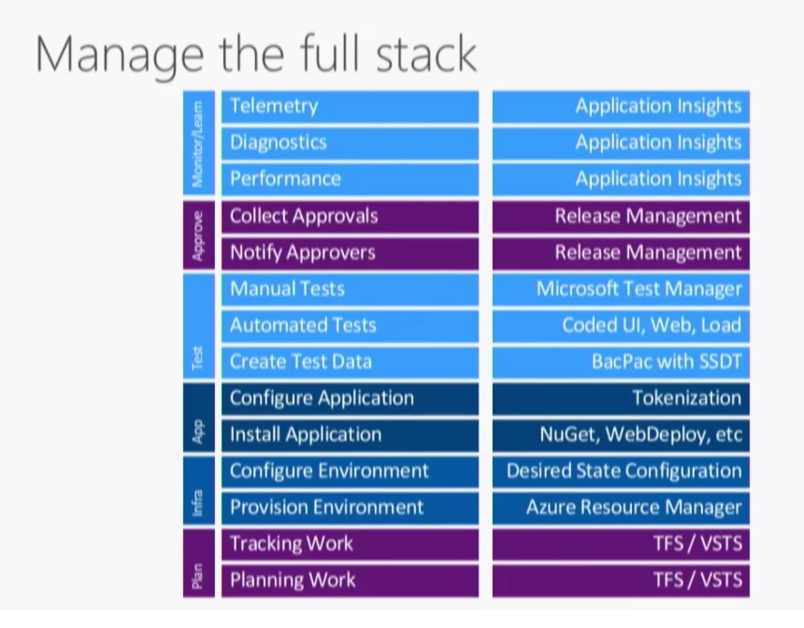

Slide 13


Visual Studio Team Services
Any Language
Any Platform

Slide 14

Visual Studio Team Services
Program in Any Language
.NET
Java
Python
Ruby
Nodejs
Develop on any OS
Linux
Mac
Windows
Notes:
Microsoft Development Tools – NOTE: long slide

Slide 15
Visual Studio Team Services
Deploy to any Platform
Android
iOS
Docker
Azure
AWS
Linux
Mac
Windows Phone

Slide 16
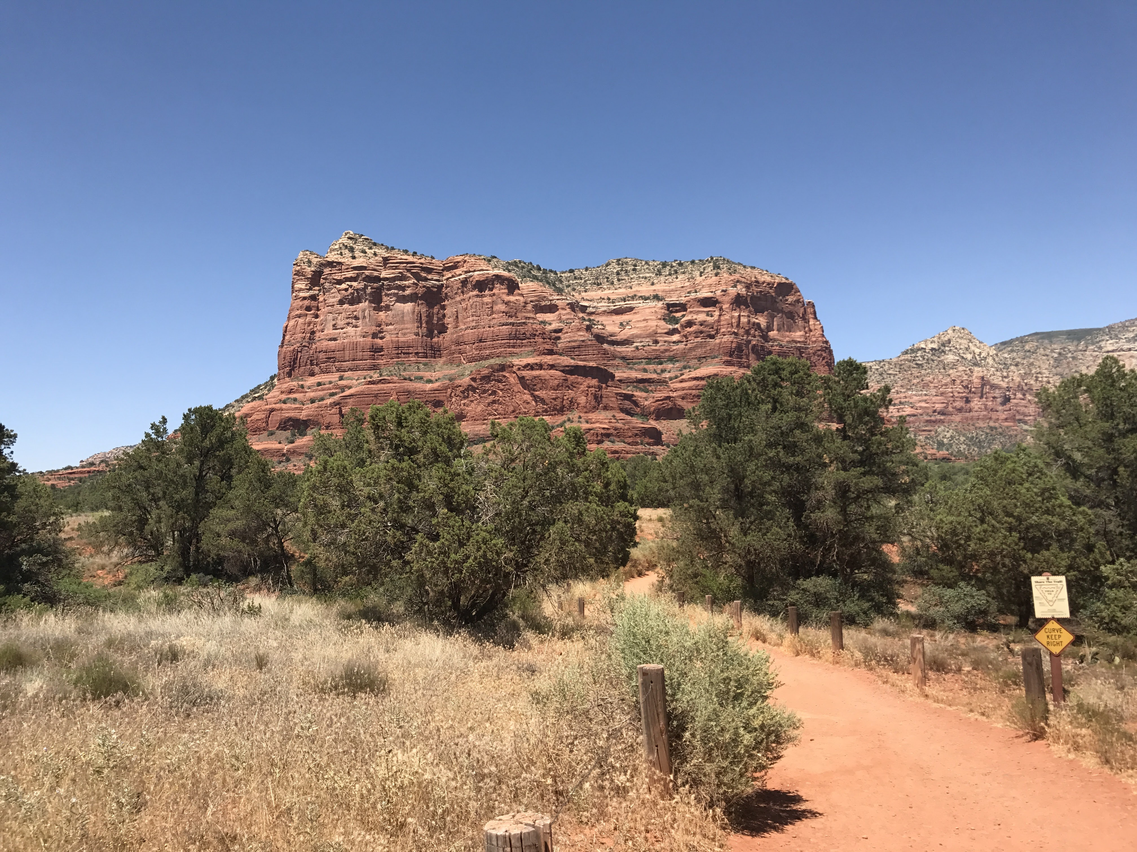
Demo
Demo
Notes:
For first demo let’s just go explore around Visual Studio Team Services and Azure Portal

Slide 17
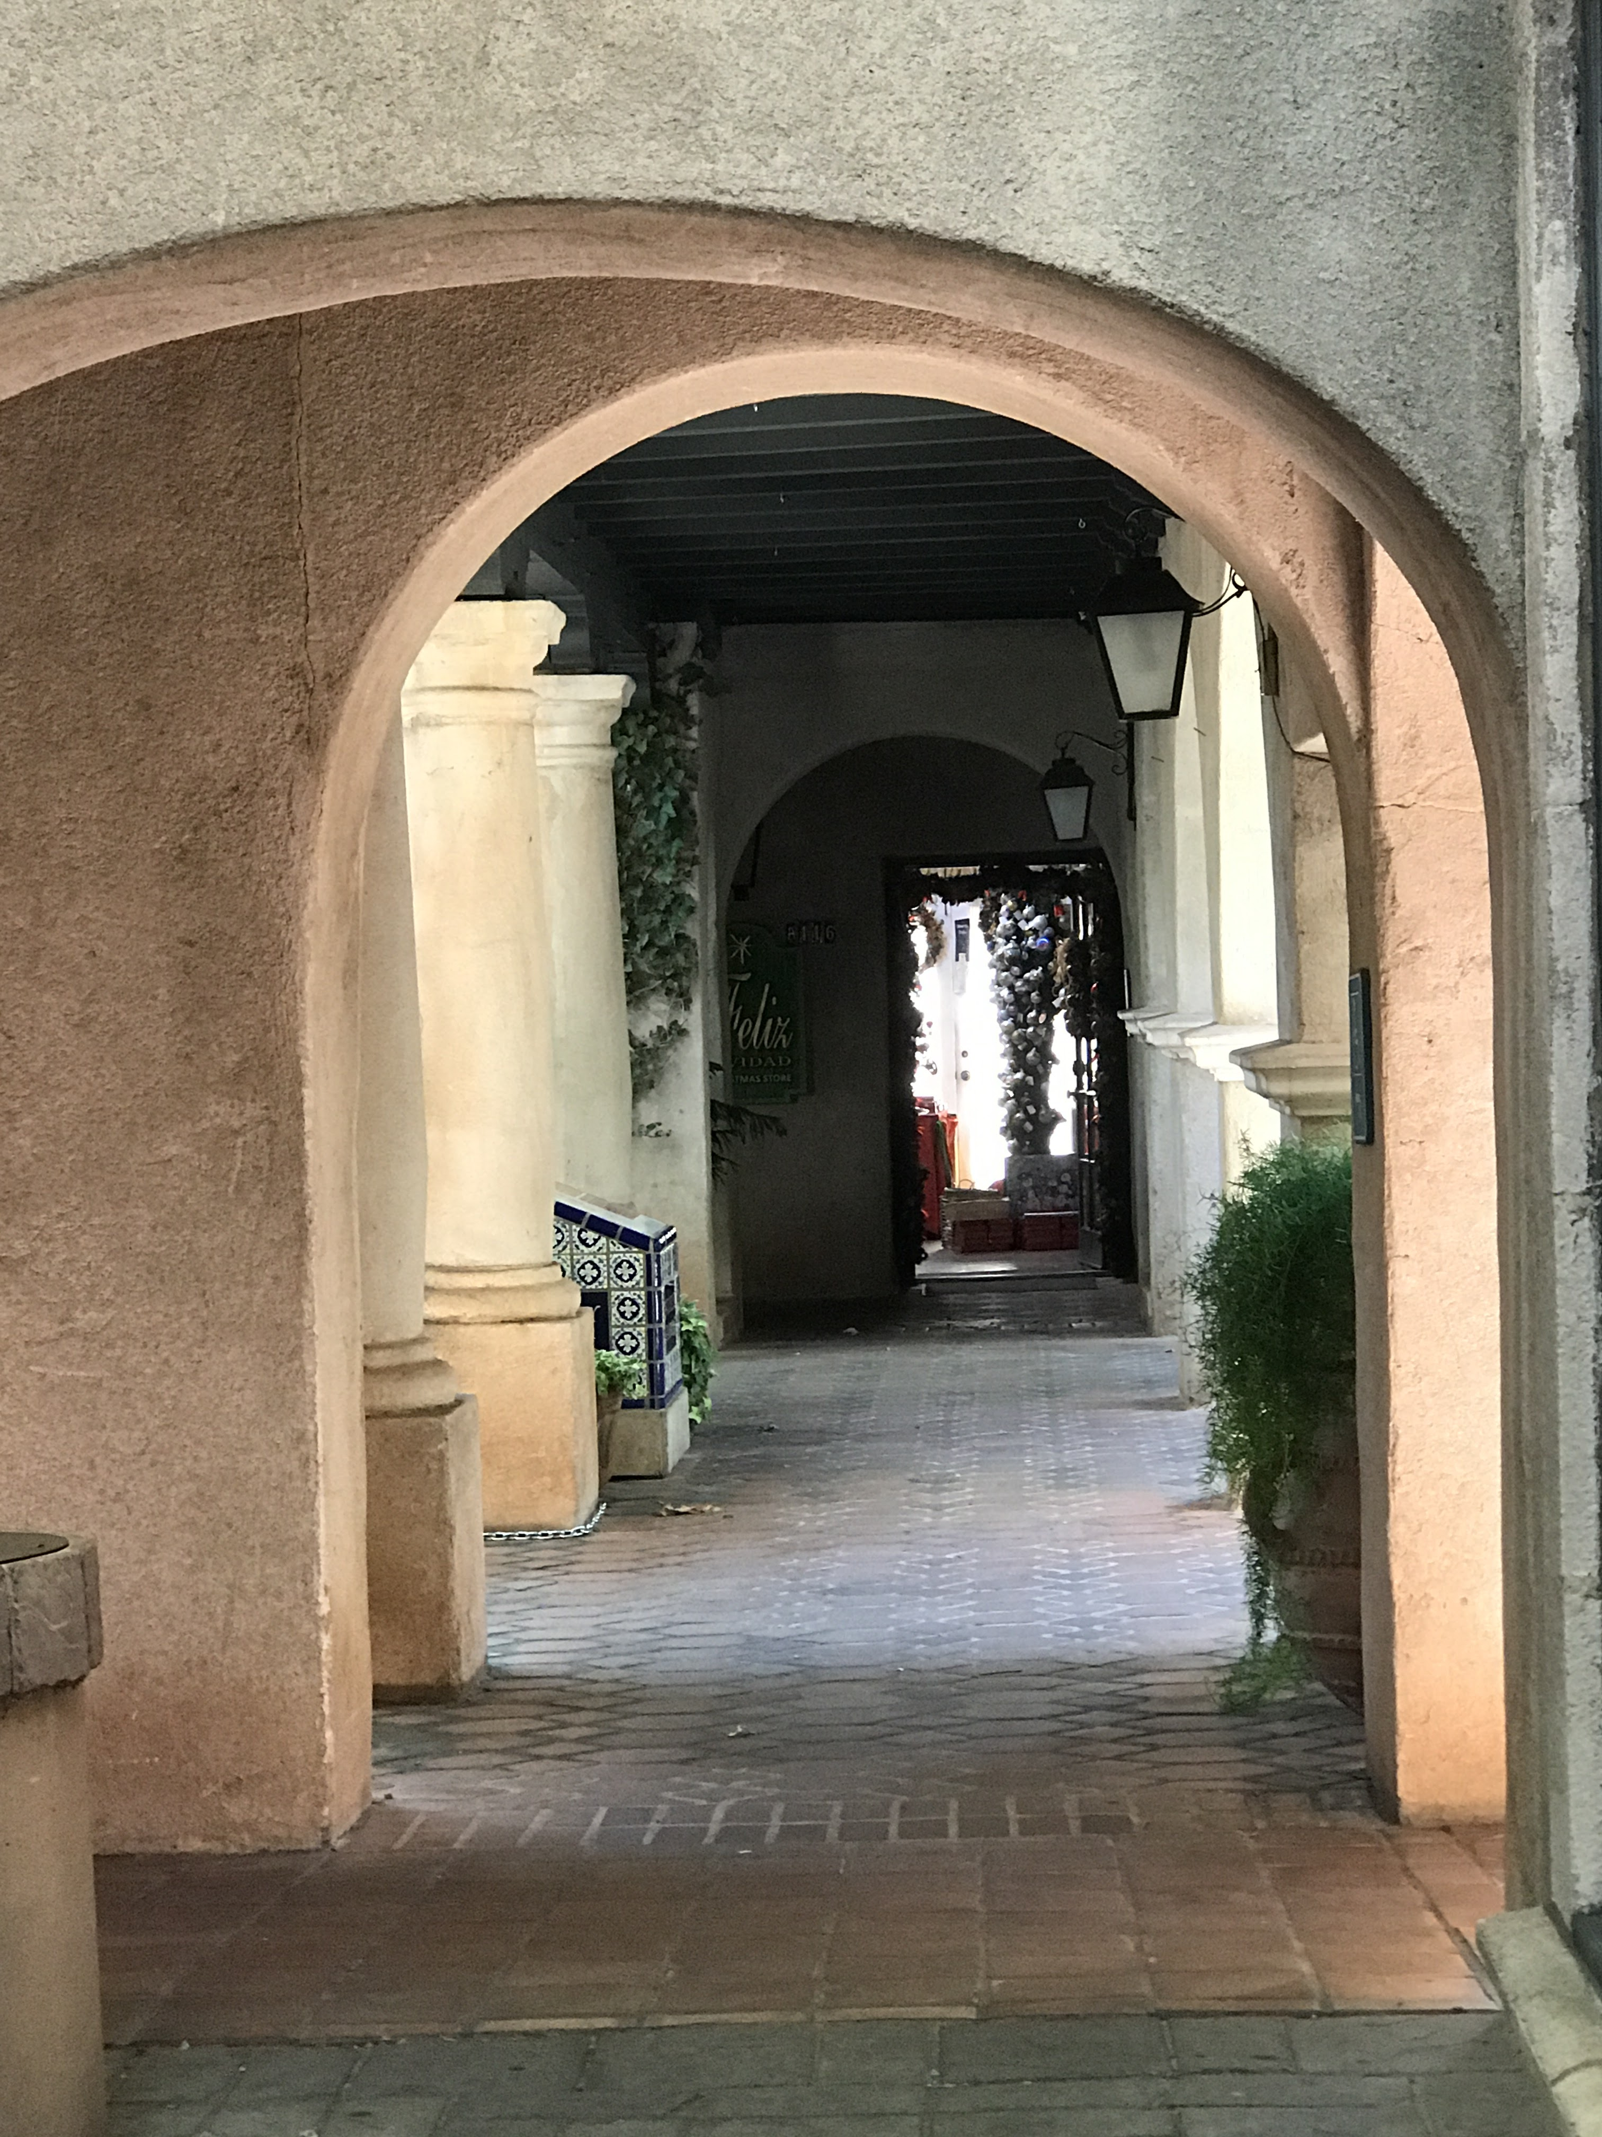
Automation
Visual Studio 2017
Yeoman
Notes:
Microsoft Development Tools – NOTE: long slide

Slide 18
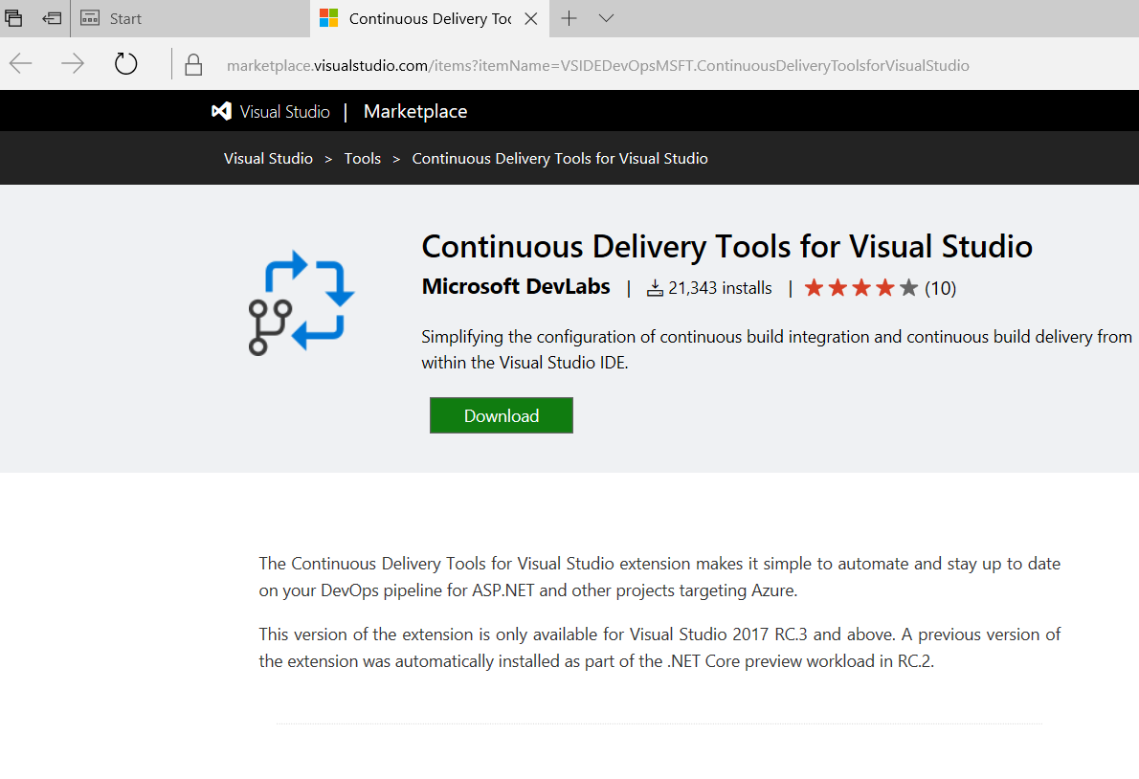
Notes:
Microsoft Development Tools – NOTE: long slide

Slide 19
Demo
Demo
Notes:
2nd Demo – go with the Yo Team series.

Slide 20

Questions?

Slide 21
Dave Milner - Phidiax
Sr. Collaboration & Cloud Architect
Contact
Twitter @davemilner
David.Milner@Phidiax.com
Blog – www.davemilner.com
Github
https://github.com/davemilner

Slide 22
Resources
Content at Github:
https://github.com/DarqueWarrior/generator-team
https://github.com/davemilner/DenverDevDays
https://github.com/davemilner/h2oforlife
eBook:
Continuous Delivery: Reliable Software Releases Through Build, Test, and Deployment Automation – Jez Humble & David Farley - https://www.amazon.com/gp/product/0321601912
Containerized Docker Application Lifecycle With Microsoft Platform and Tools - https://www.microsoft.com/en-us/download/details.aspx?id=54266
Resources:
From 0 to DevOps – Donovan Brown – Ignite New Zealand - https://channel9.msdn.com/Events/Ignite/New-Zealand-2016/M328
Build a CI/CD pipeline from Visual Studio - https://channel9.msdn.com/Events/Build/2017/P4105
Continuous Delivery Website – continousdelivery.com – Jez Humble
VSTS Documentation - https://www.visualstudio.com/en-us/docs/build/overview
Manual CD ASP.NET Core - https://www.visualstudio.com/en-us/docs/build/apps/aspnet/aspnetcore-to-azure

Slide 23

Thank You!
Call to Action !!!
Take Advantage of latest advances in DevOps Tooling
Drive value to your Customers through Continuous Delivery

Slide 24
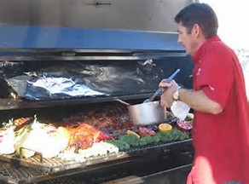
Rub a Little DevOps On It!

Slide 25

Denver Dev Day - June 23, 2017
"Donations by YOU, Denver Dev Day attendees,
are provided to support KidsTek, http://kidstek.org - Thank you!"

